Slide 1


RE
Objectives

Slide 2
RE
Data Sources and Analysis Model
Poverty Rates by county
Score
1
1
Population growth rate by county
Population Growth / New Build Permits (higher is better)
Score
1
Houses built after 2020, by county (proxy for build counts)
1
Average Mortgage Price, by county
Add up scores and rank
Rent – Mortgage = Rent advantage (higher is better)
Score
1
Average Rent Price, by county
2
Median Income, by county
Median Income / Median Home Price (higher is better)
Score
1
Median Home Price, by county
1
Median Increase in Home Value, by county
Used for comparison and correlation studies
https://www.huduser.gov/portal/datasets/home-ownership-value-limits.html#year2020
https://data.census.gov/
1
2

Slide 3
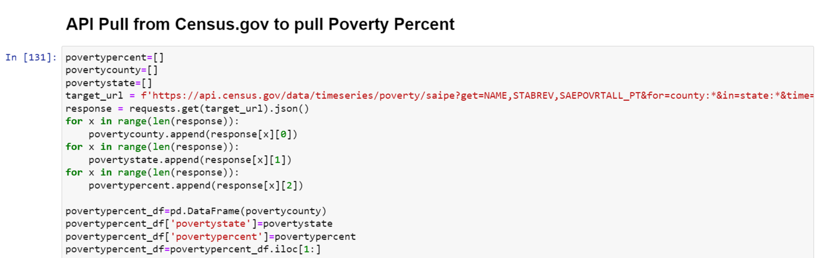
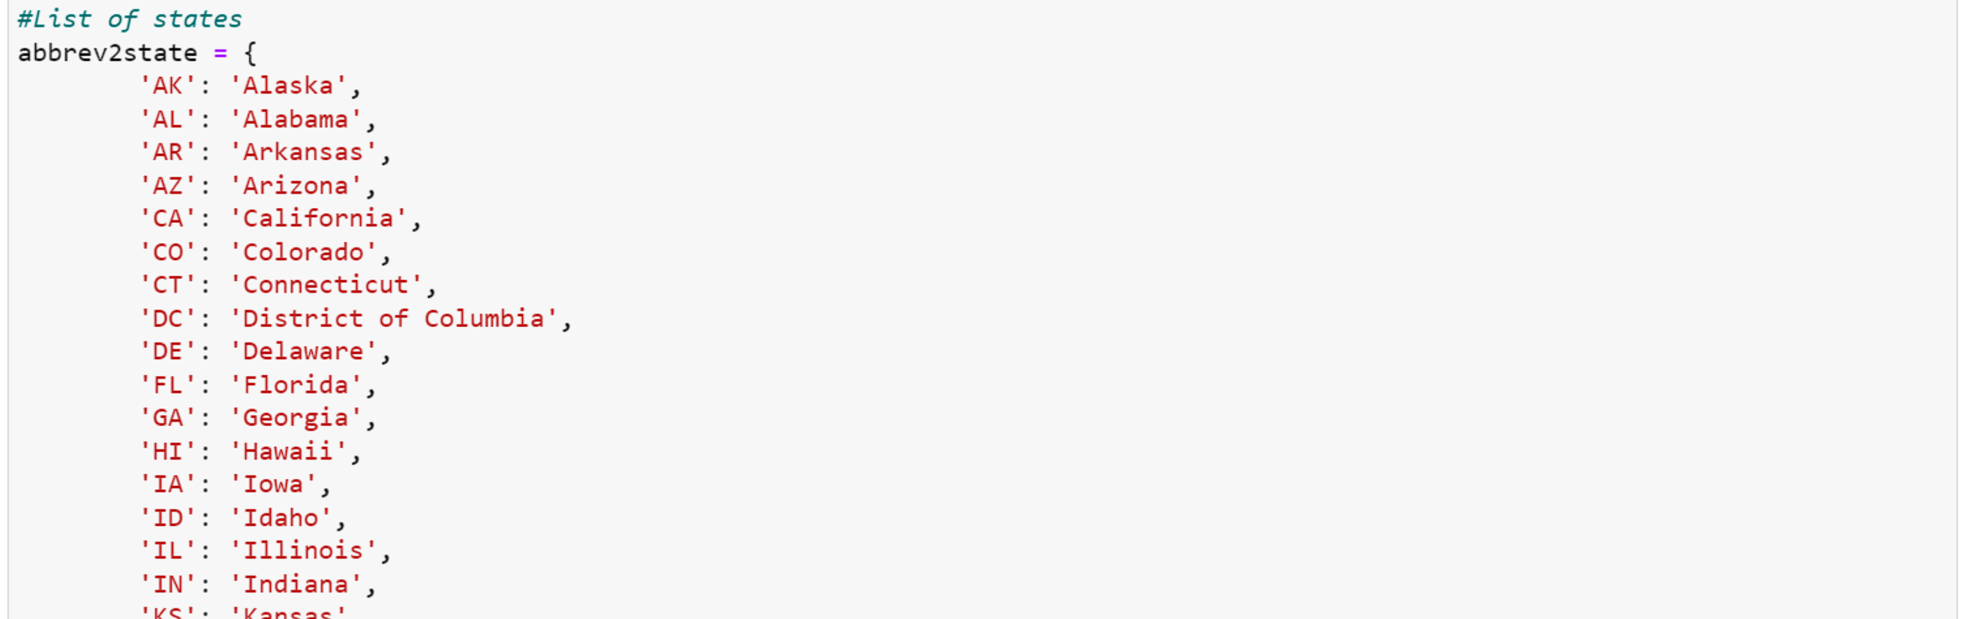
OW

Slide 4
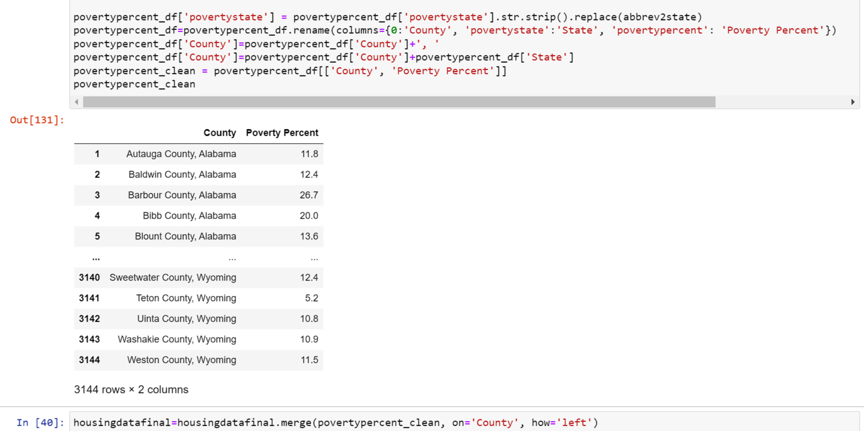
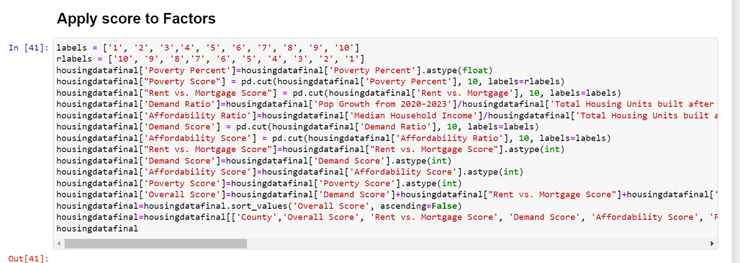
OW

Slide 5
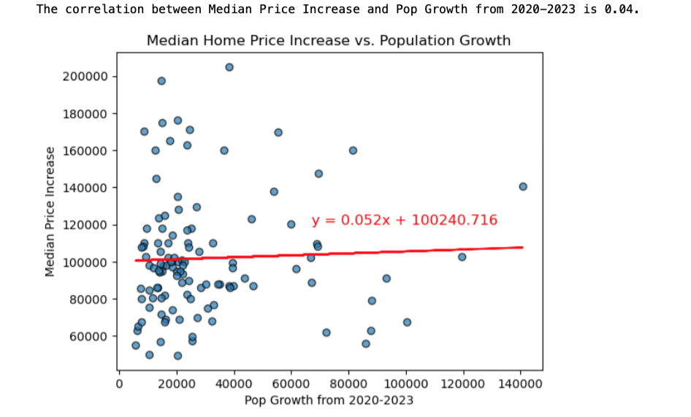
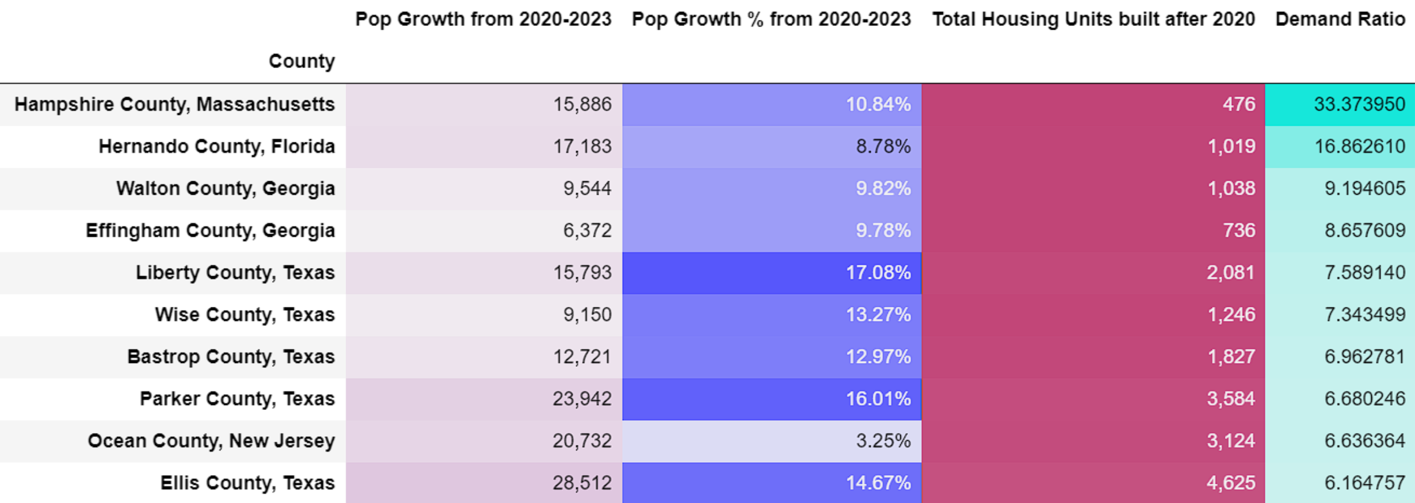
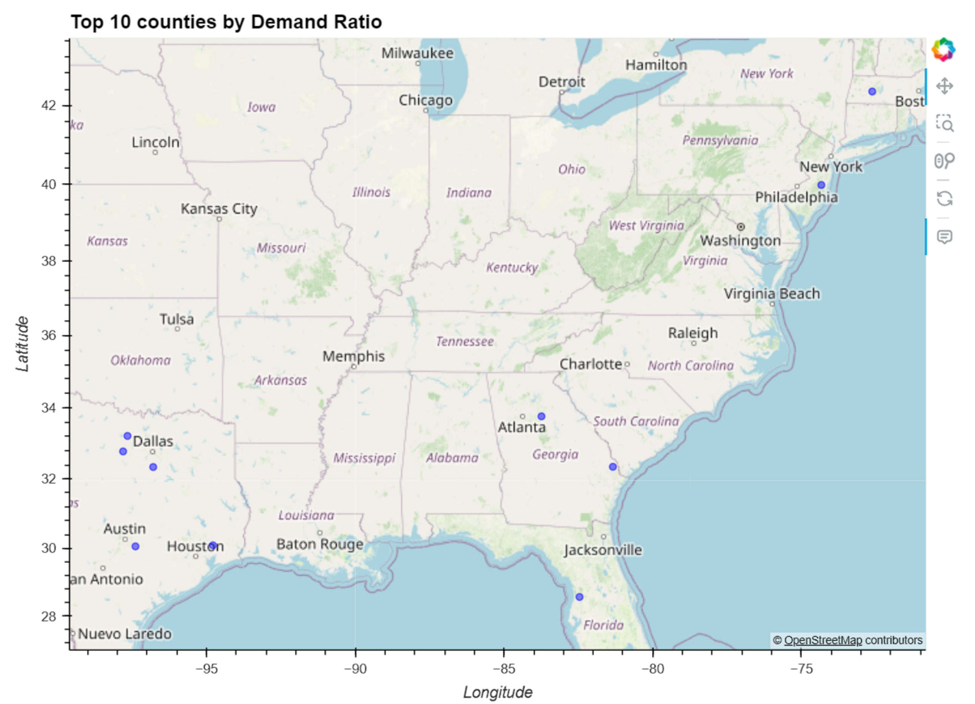

AP
Findings: Average Population Growth as Gross Increase, Percentage Increase, and Total Housing Units Built
Top 10 Counties by Demand Ratio

Slide 6
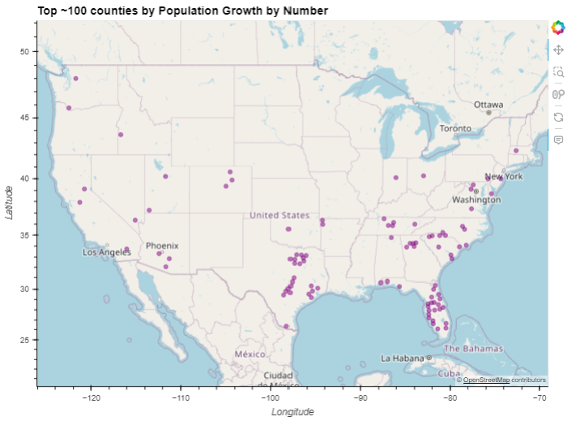
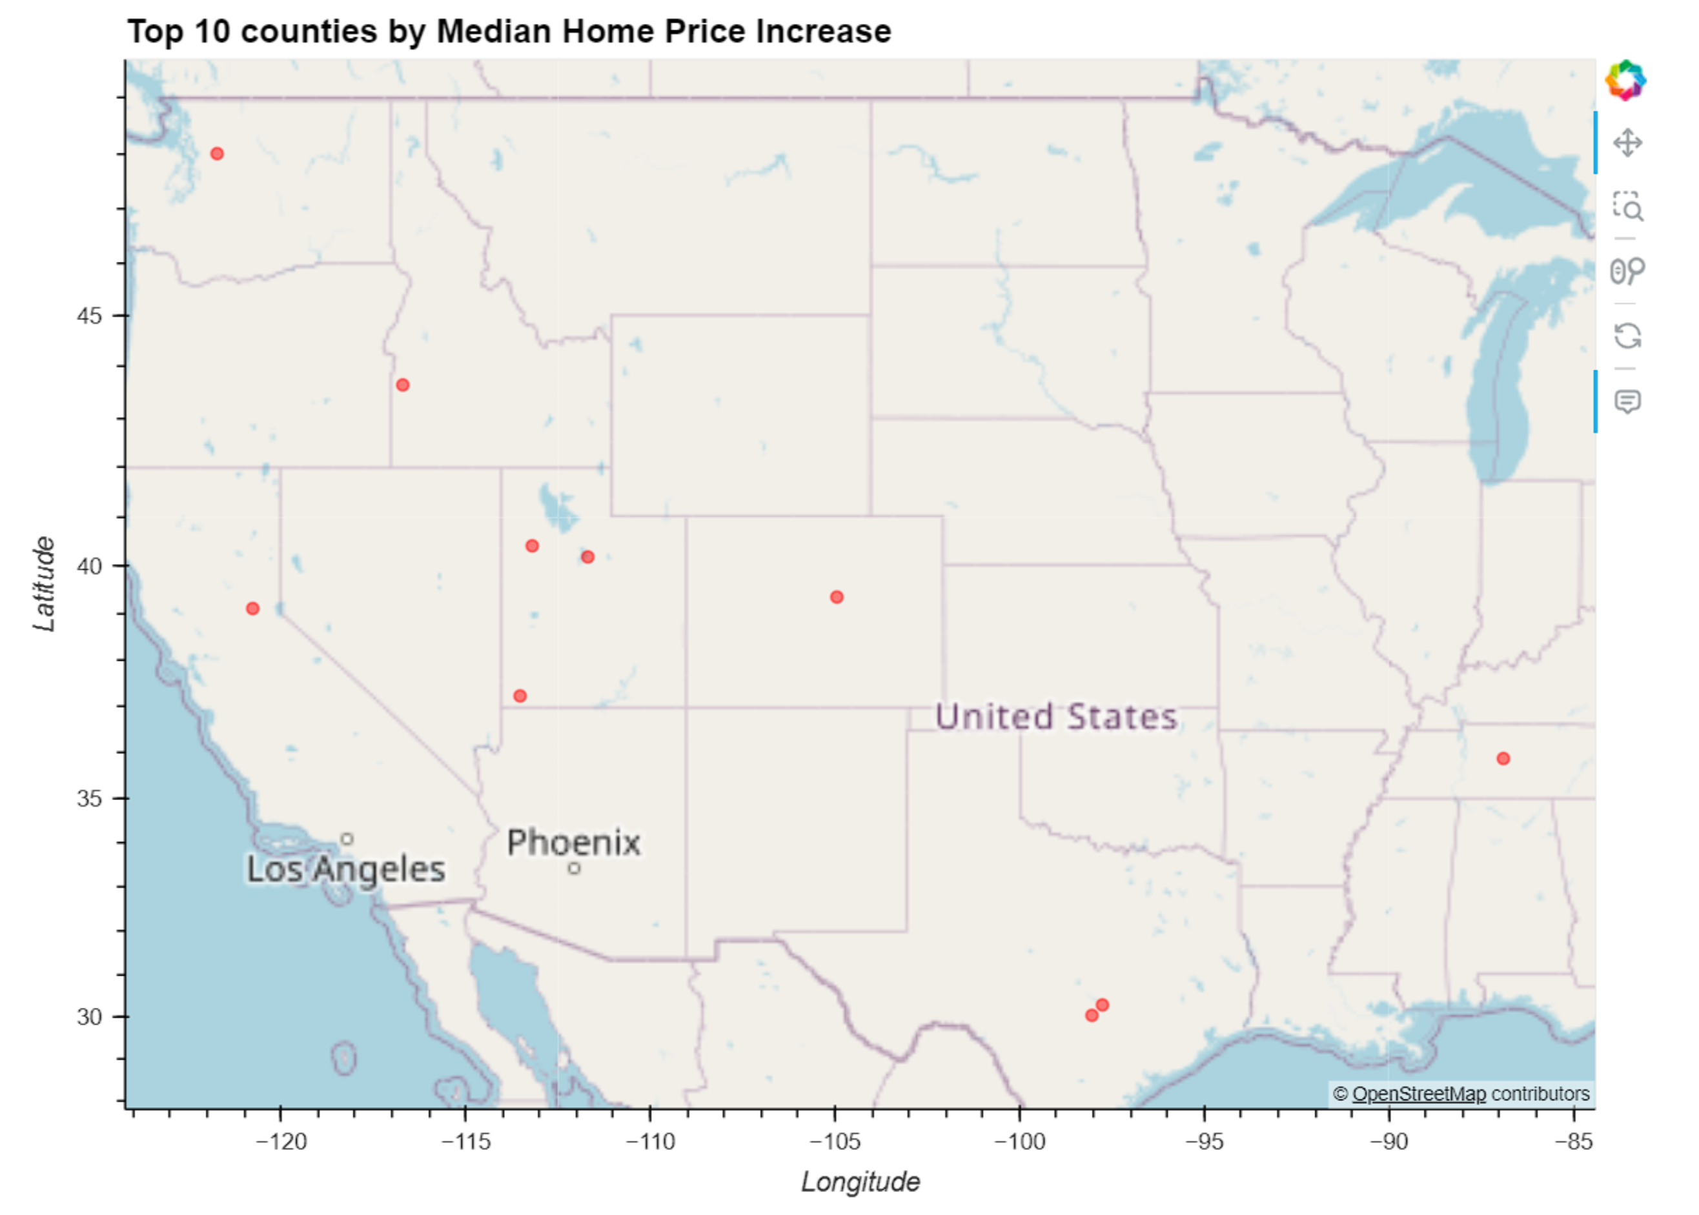
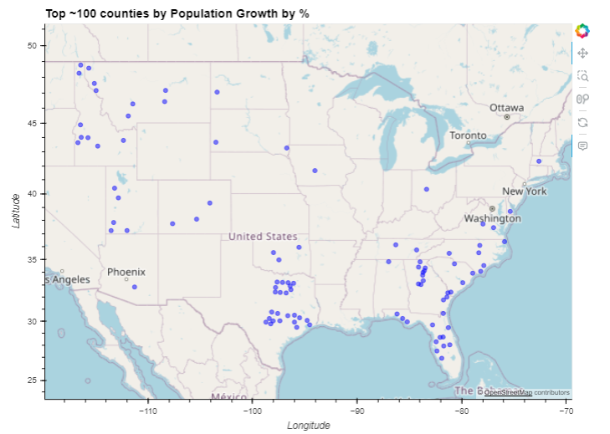
AP
Findings: Average Population Growth as Gross Increase, Percentage Increase, and Total Housing Units Built
Top 10 Counties by Demand Ratio
Top ~100 Counties by Population Growth (Number)
Top 10 Counties by Median Home Price Increase
Top ~100 Counties by Population Growth (%)

Slide 7
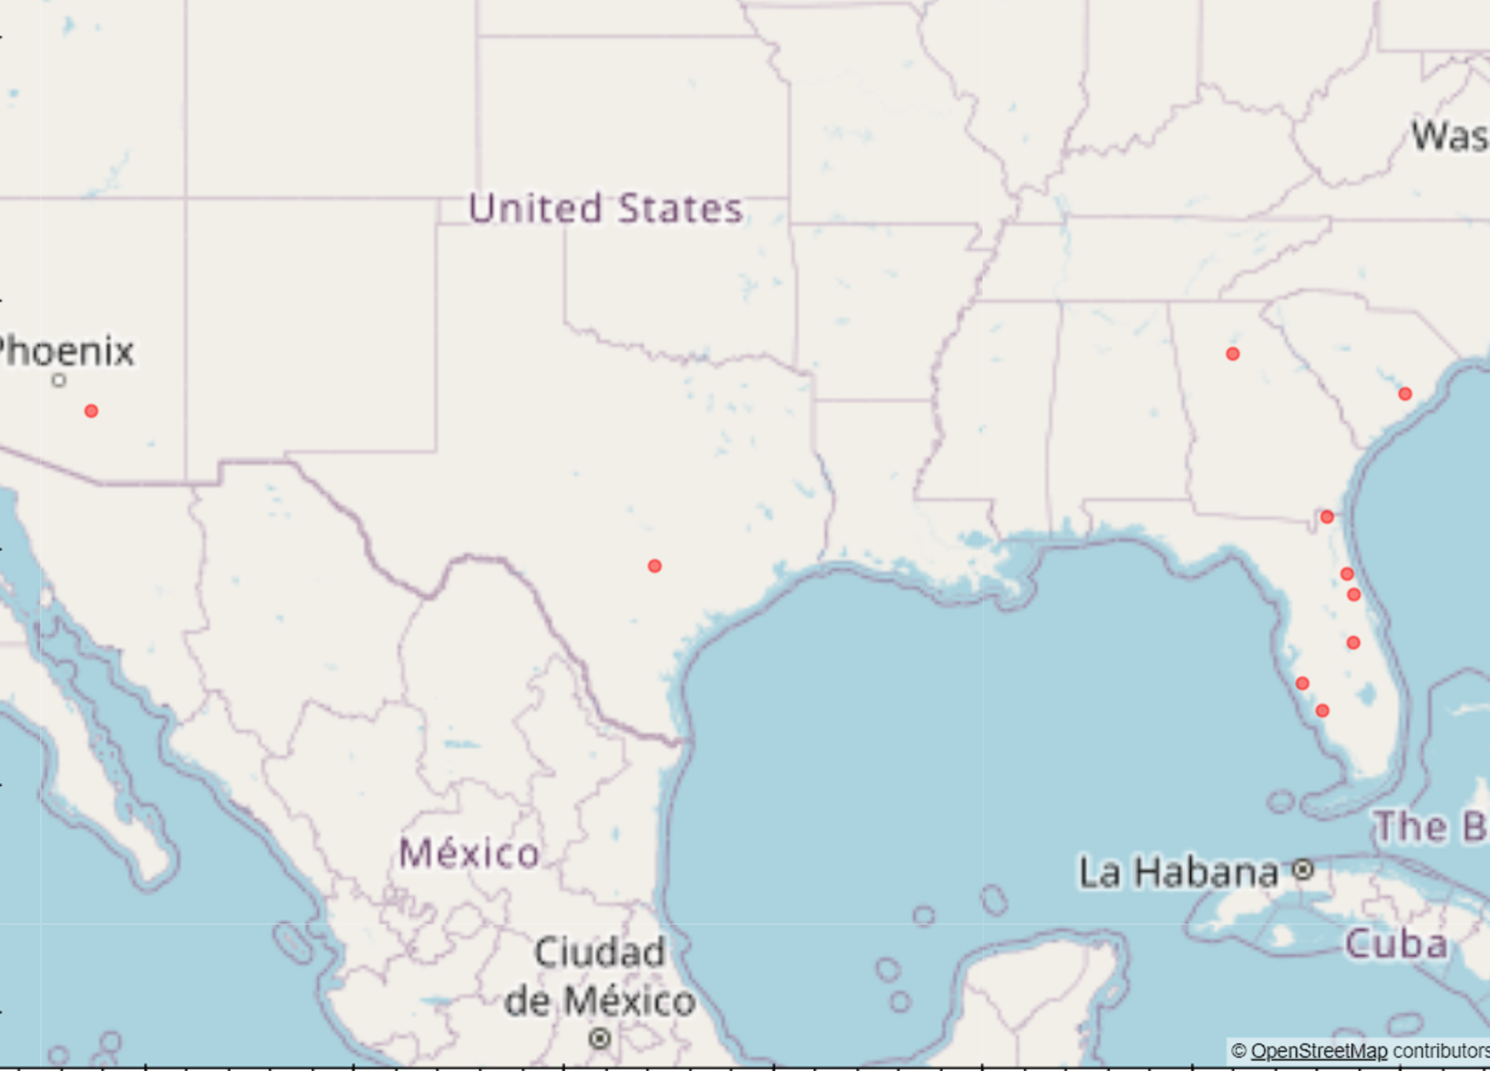
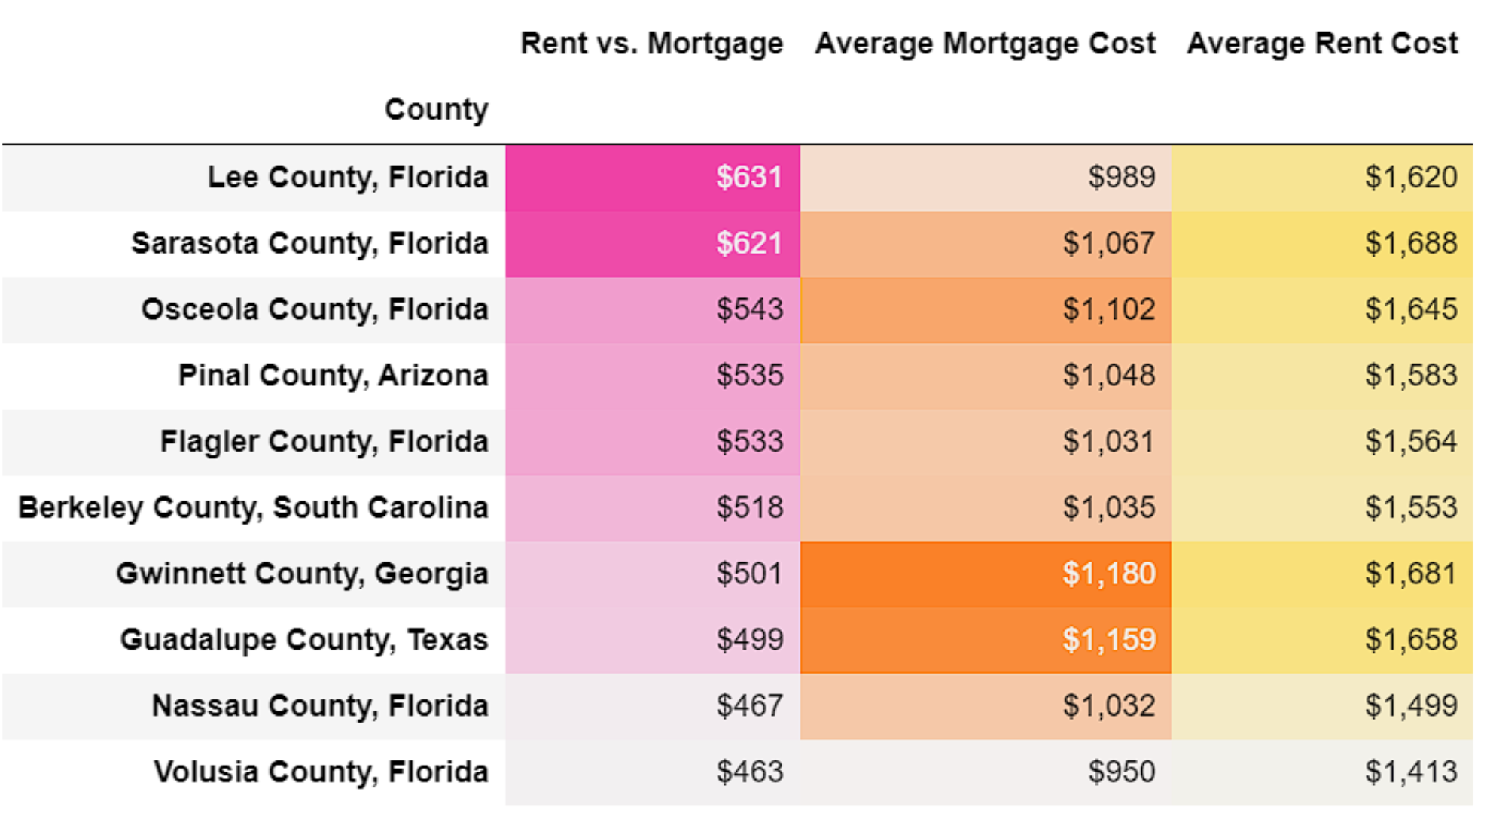
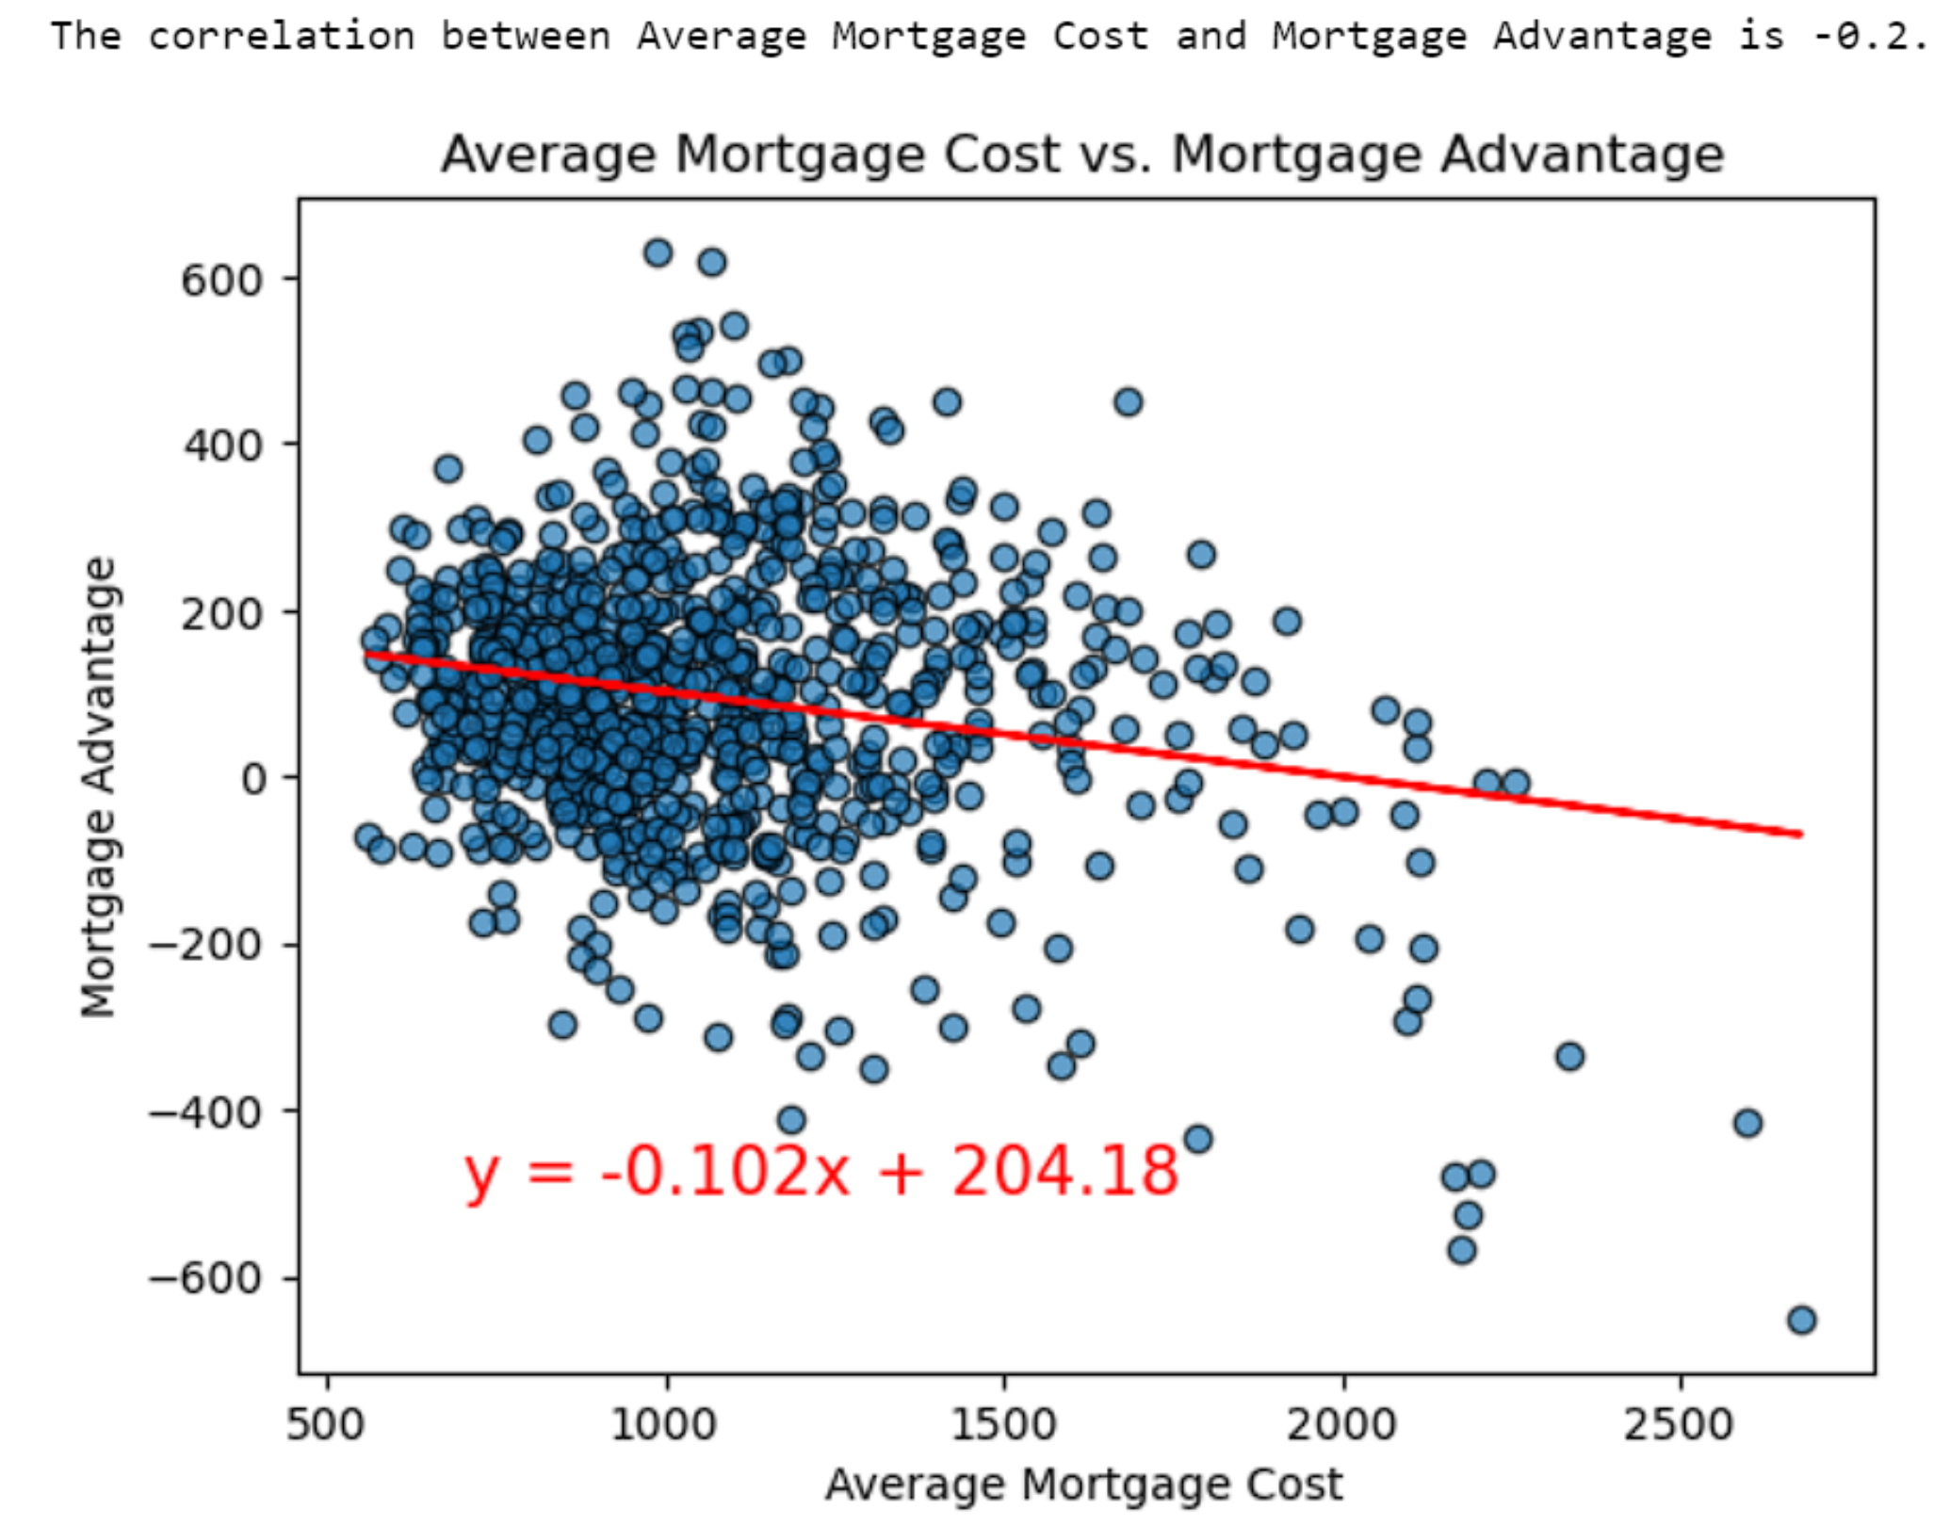
AD
Findings: Average Mortgage Advantage, Mortgage Price, and Rent
Top 10 Counties by Mortgage Advantage
Mortgage Advantage

Slide 8

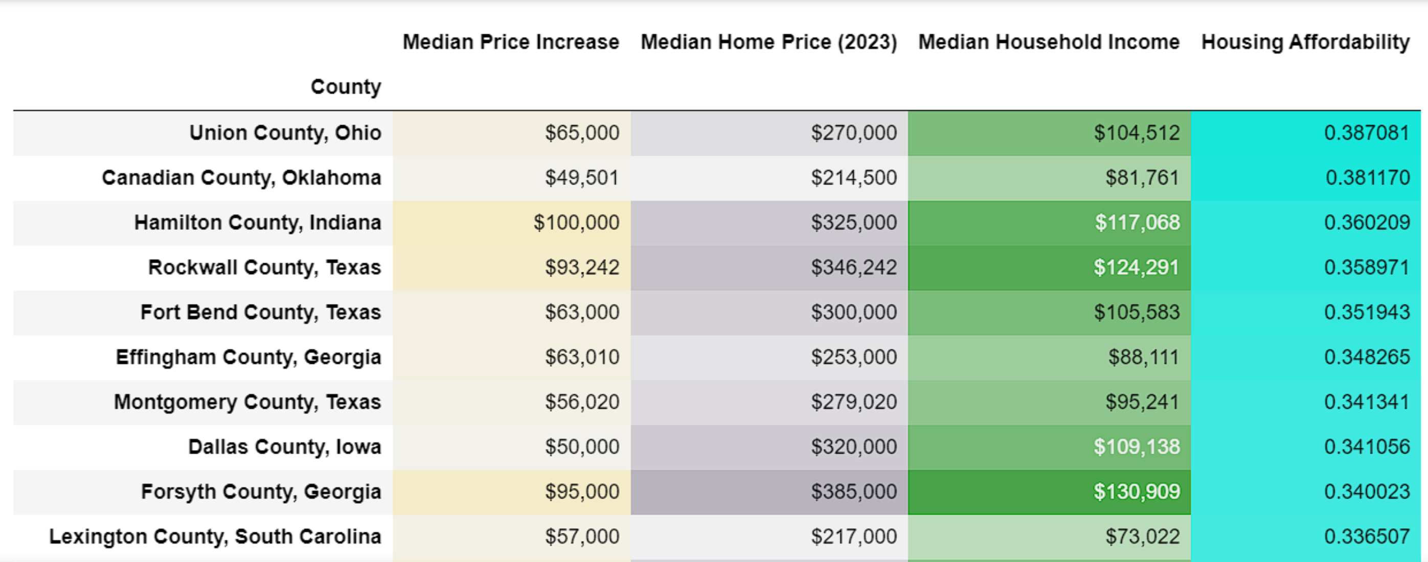
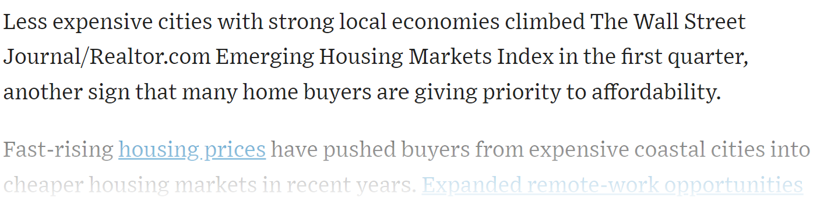
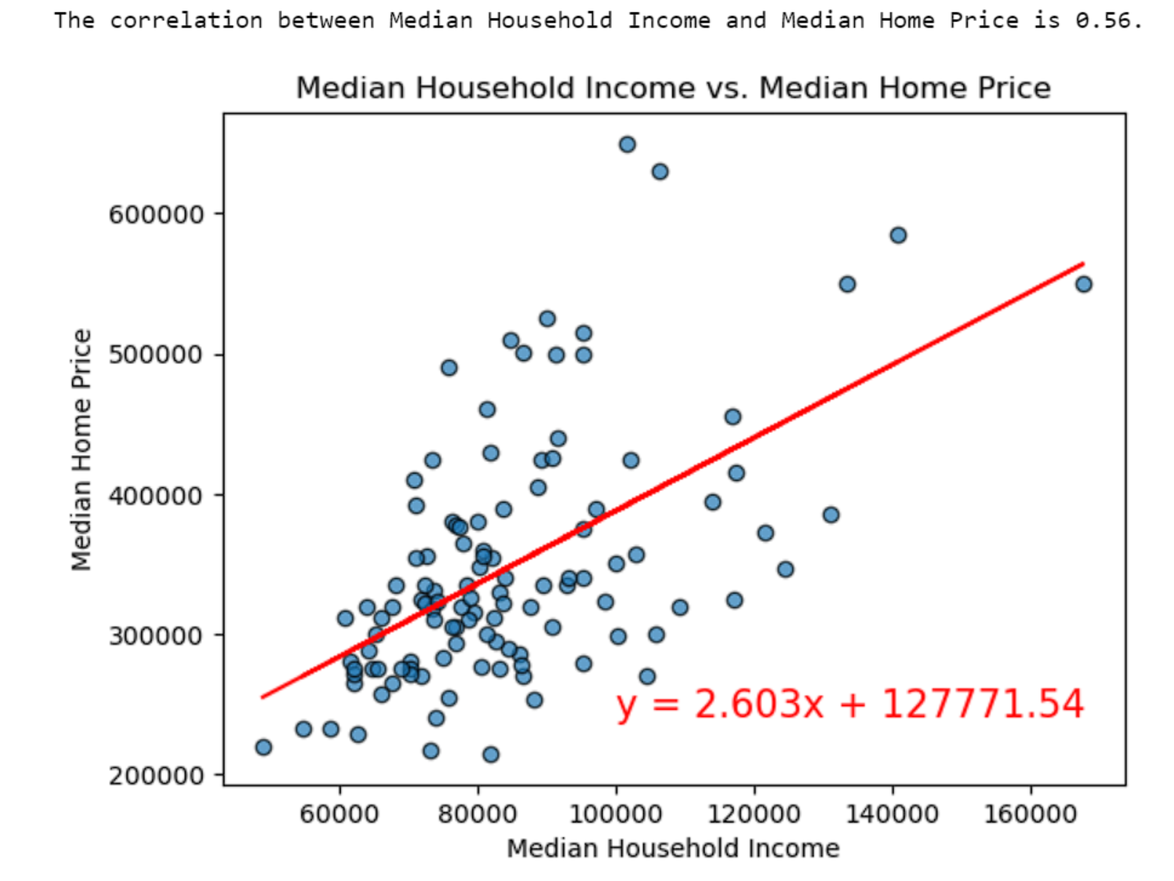
AD
Findings: Median Increase in Home Value, Median Income, Median Home Price
Top 10 Counties by Median Home Price Increase
Note: US Median Household Income is ~$75k

Slide 9
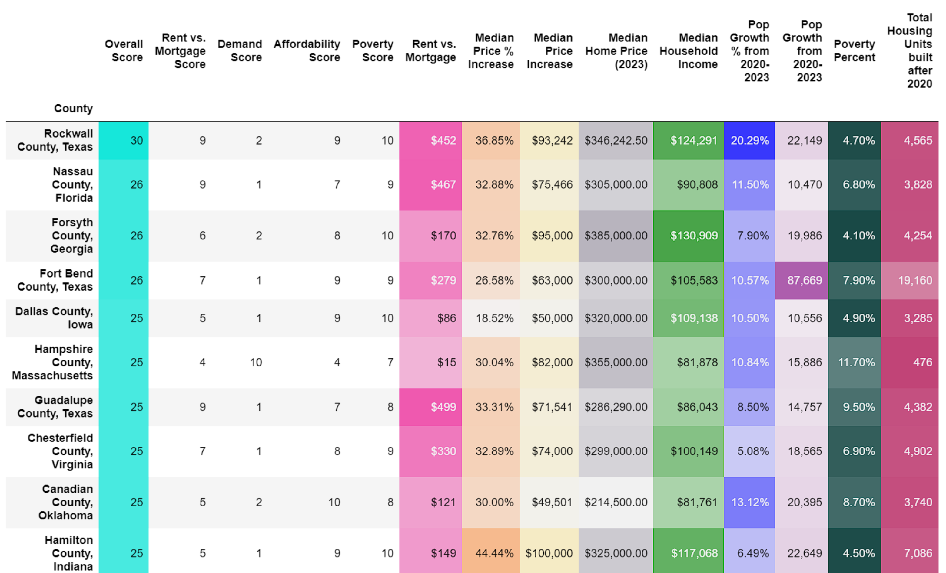
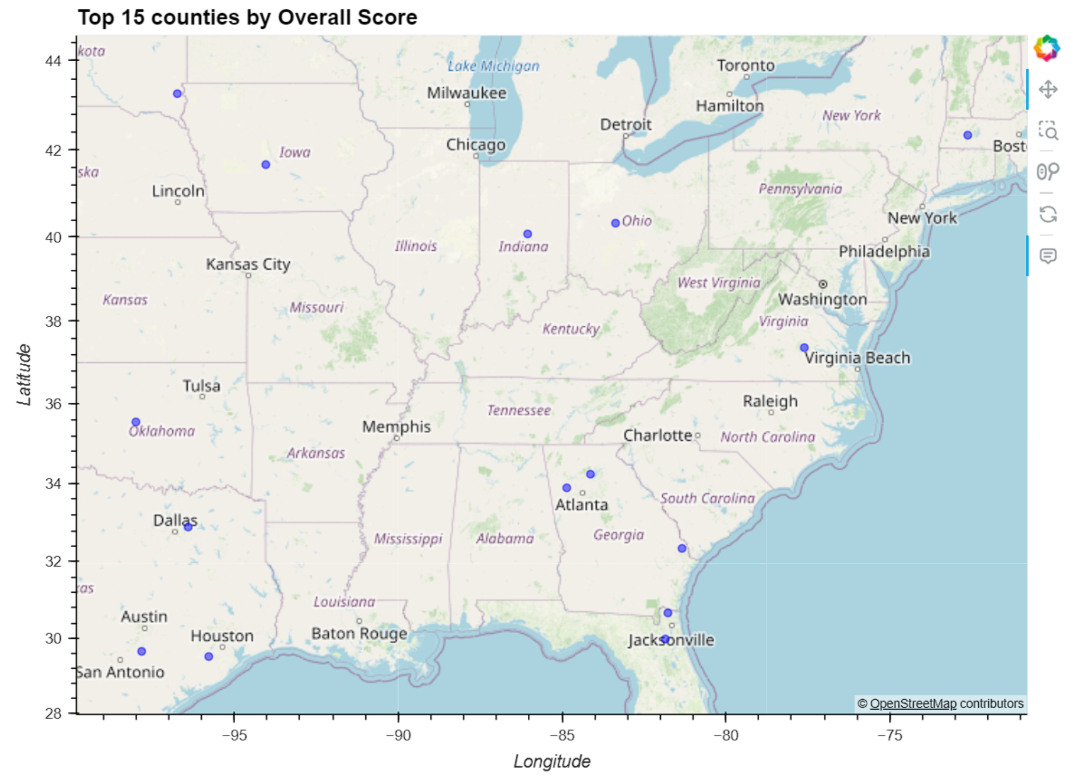
NW
Overall Scores

Slide 10
NW
Things we would improve if we had more time
Additional quantitative and qualitative research is needed to validate our findings
A major weakness of our data is it’s based on historical data that coincides with a major sociological event (COVID) and future trends could change or even reverse
WFH urban exodus reverses due to RTO
Average mortgage rate on outstanding loans at 3.1% (CoreLogic), but average rate today is 7.08% (Bankrate)
Many pricing gains have been realized, so is the opportunity gone?
Are our findings off, or do they represent arbitrage opportunities?
All our bins were weighted equally, but we should conduct sensitivity analysis and add weighting to our scores, or apply minimum thresholds?
Sources: https://www.bankrate.com/mortgages/mortgage-rates/ ; https://www.corelogic.com/intelligence/higher-mortgage-rates-lead-to-strong-lock-in-effect/#:~:text=With%20current%20mortgage%20rates%20at,fell%20starting%20in%20July%202022.

Slide 11
RE
Data Sources and Analysis Model
Create 10 bins split by even ranges, then scored 1-10, with 10 being more advantageous
Poverty Rates by county
Score
1
2
Population growth rate by county
Population Growth / New Build Permits (higher is better)
Score
3
Houses built after 2020, by county (proxy for build counts)
4
Average Mortgage Price, by county
Add up scores and rank
Rent – Mortgage = Rent advantage (higher is better)
Score
5
Average Rent Price, by county
6
Median Income, by county
Median Income / Median Home Price (higher is better)
Score
7
Median Home Price, by County
8
Median Increase in Home Value
Used for comparison and correlation studies

